Slide 1
Visualizing Sustainability: A Cognos-Based Analysis Of Global Trends (2000-2023)
P.CHANDRALEKHA
Assistant Professor
Anand Institute Of Higher Technology, Chennai

Slide 2

Project Description
The Sustainable Development Report (SDR) reviews progress made each year on the Sustainable Development Goals since their adoption by the 193 UN Member States in 2015. At the halfway mark to 2030, the Sustainable Development Report 2023 takes stock of progress made and discusses priorities to restore and accelerate SDG progress. Published on the eve of the 2023 Paris Summit for a New Global Financial Pact, this year’s edition focuses specifically on the need to scale up development finance and to reform the global financial architecture to support the SDGs.

Slide 3
Define Problem / Problem Understanding
Problem Understanding
Specify the business problem
Business requirements
Social or Business Impact
Literature Survey

Slide 4
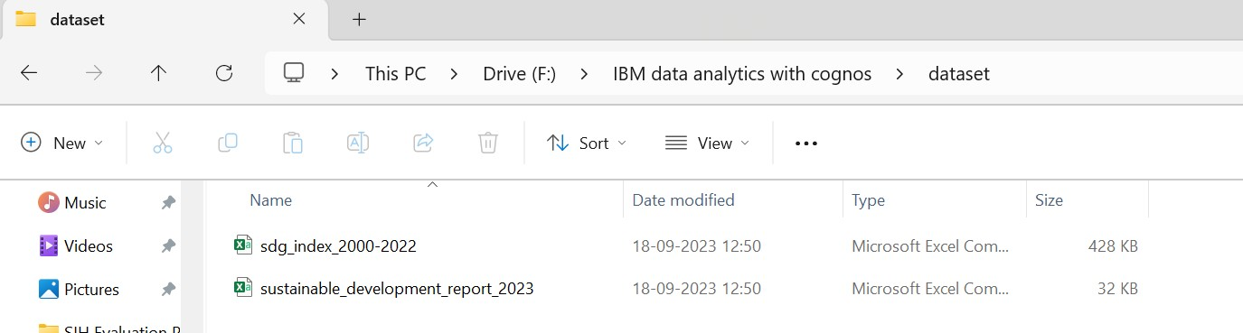
Data Collection & Extraction from Database
Collect the dataset
Data collection is the process of gathering and measuring information on variables of interest, in an established systematic fashion that enables one to answer stated research questions, test hypotheses, and evaluate outcomes and generate insights from the data.

Slide 5
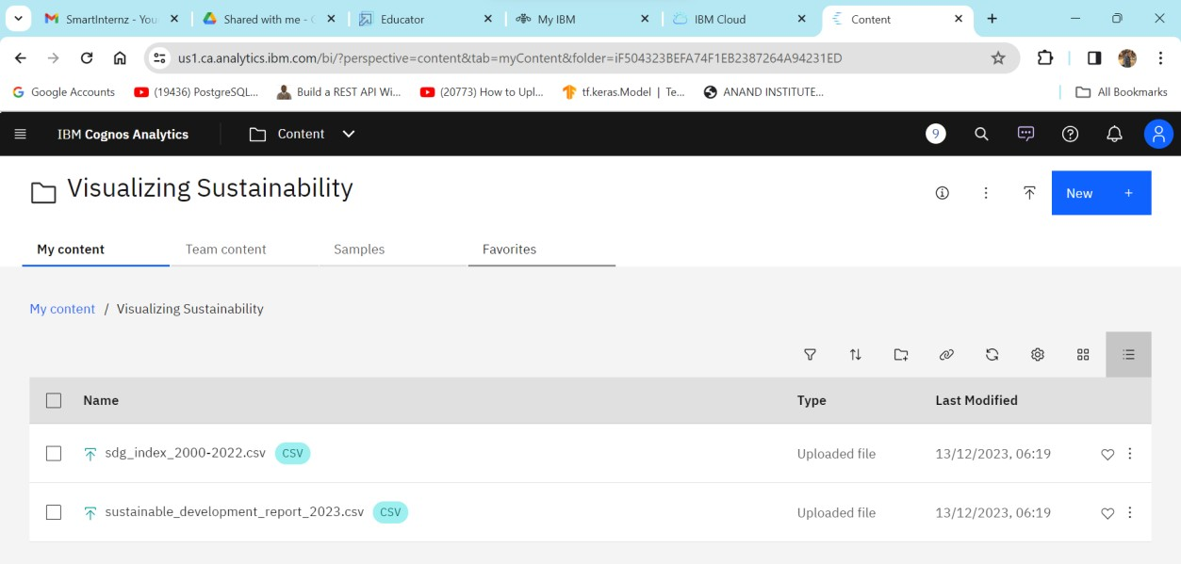
Connect IBM DB2 with IBM Cognos
https://us1.ca.analytics.ibm.com/bi/?perspective=ca- modeller&id=i778AC52A894A4E42A85024886DFD5553&objRef=i778AC52A 894A4E42A85024886DFD5553&tid=1443936845_1010de6ea9fd420ba91ffb
7f235fb485_sessionTemp

Slide 6
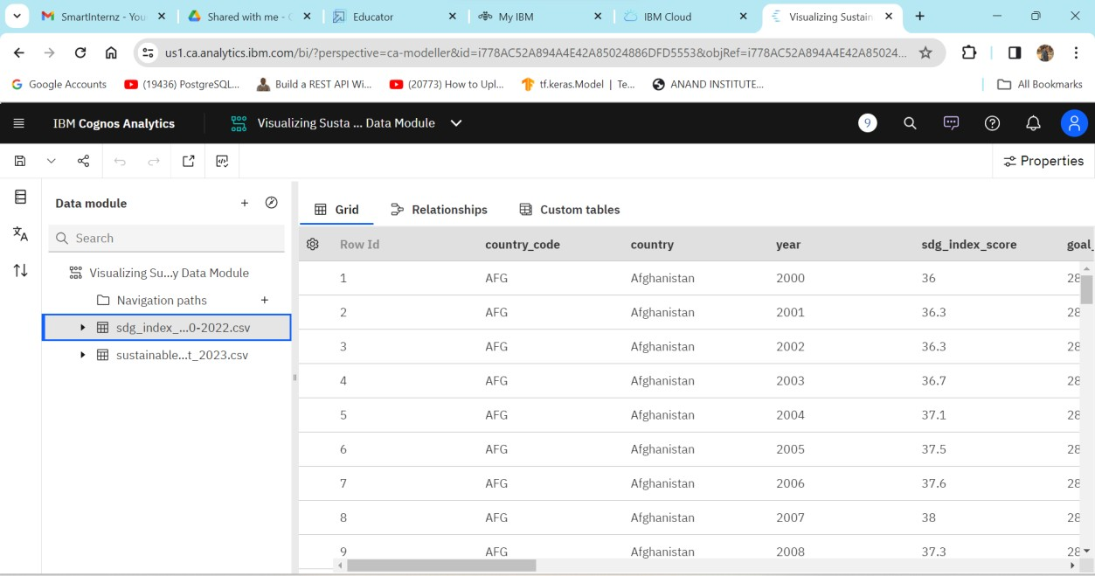
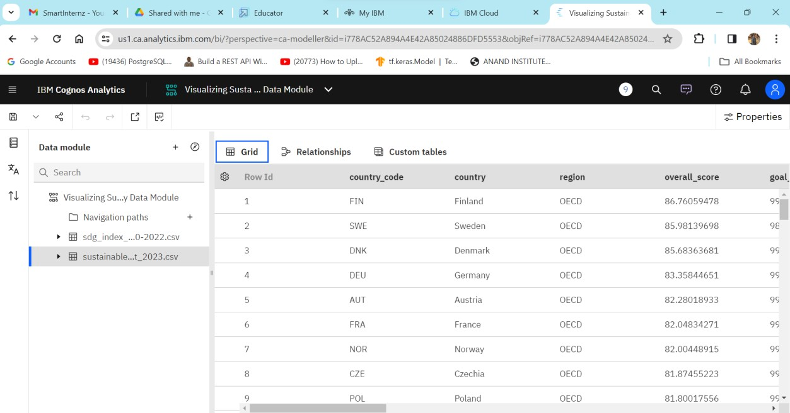
Data Preparation (Prepare the Data for Visualization)
SUSTAINABILITY _DEVELOPMENT REPORT.CSV
SDG_INDEX .CSV

Slide 7
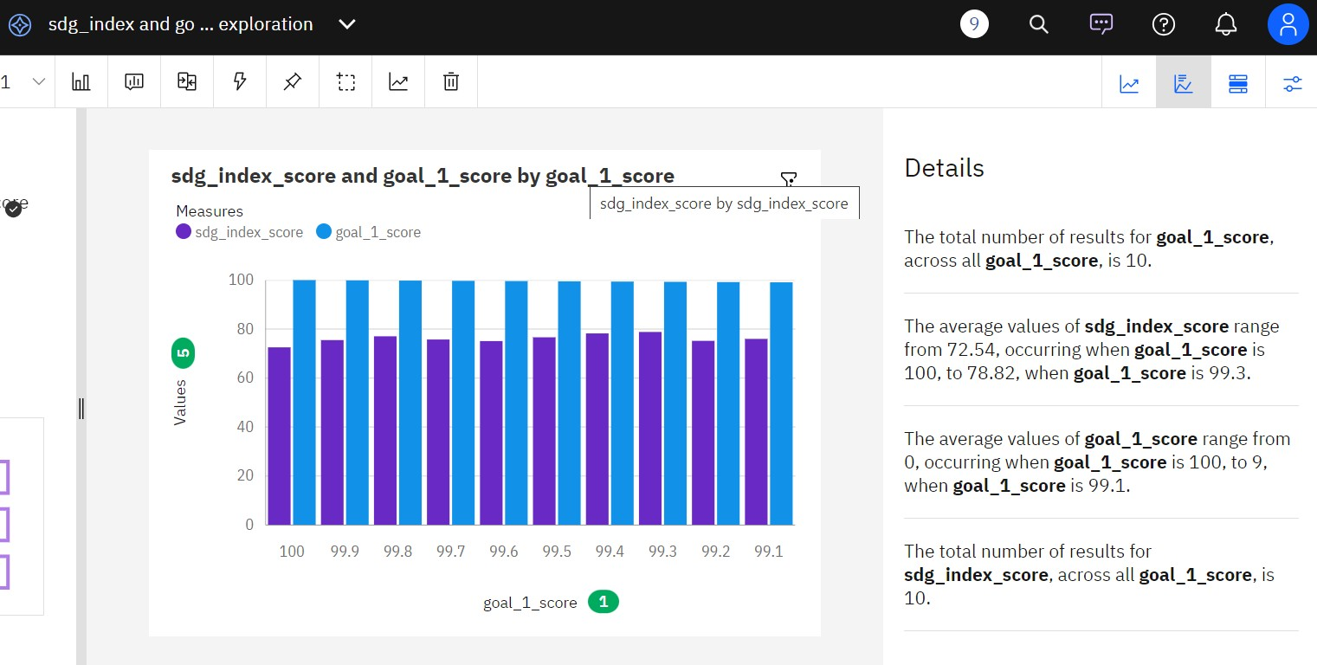
Data Visualizations(No of Unique Visualizations used 7(seven)
Analysis of Overall Sustainability on No Poverty
https://us1.ca.analytics.ibm.com/bi/?perspective=explore&pathRef=.my_folders %2Fsdg_index%2Band%2Bgoal- 1%2Bexploration&subView=model0000018c633c868e_00000000

Slide 8
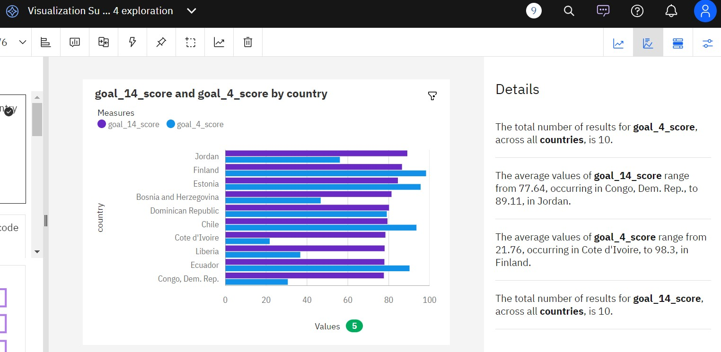
Analysis on Overall Sustainability on Quality of Education
https://us1.ca.analytics.ibm.com/bi/?perspective=explore&pathRef=.my_folders%2FVisualization%2BSustainability%2Bscore%2B14%2Band%2Bscore%2B4%2Be xploration&subView=model0000018c669ae69a_00000004

Slide 9
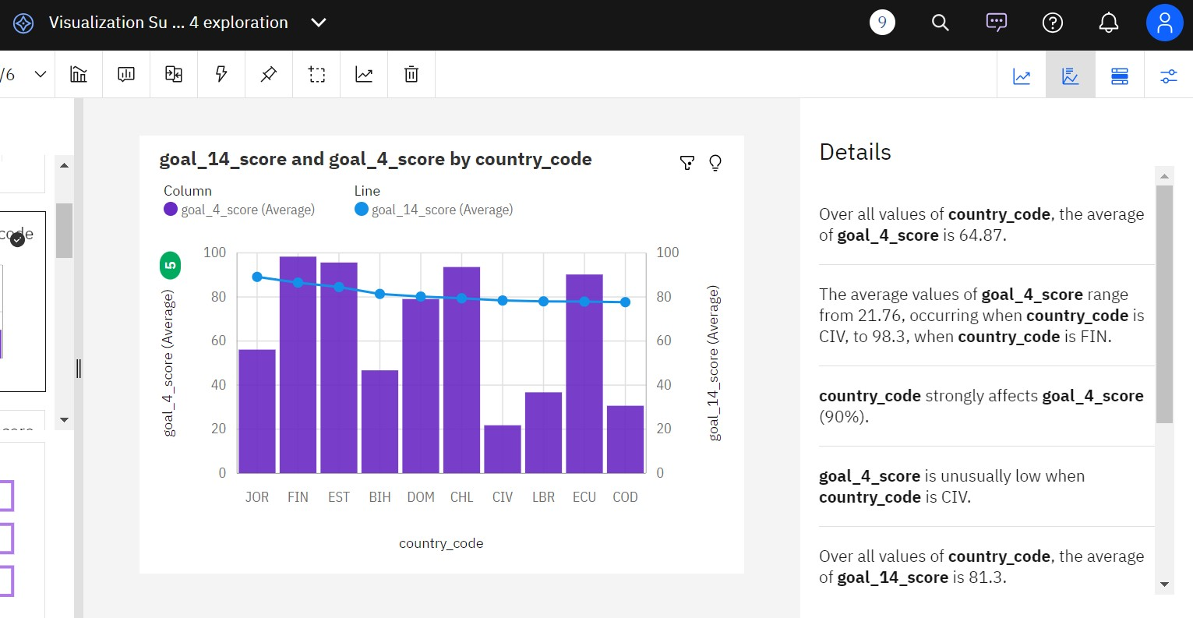
Analysis on Overall Sustainability Life Below Water
https://us1.ca.analytics.ibm.com/bi/?perspective=explore&pathRef=.my_folders
%2FVisualization%2BSustainability%2Bscore%2B14%2Band%2Bscore%2B4%2Be xploration&subView=model0000018c669ae69a_00000004

Slide 10
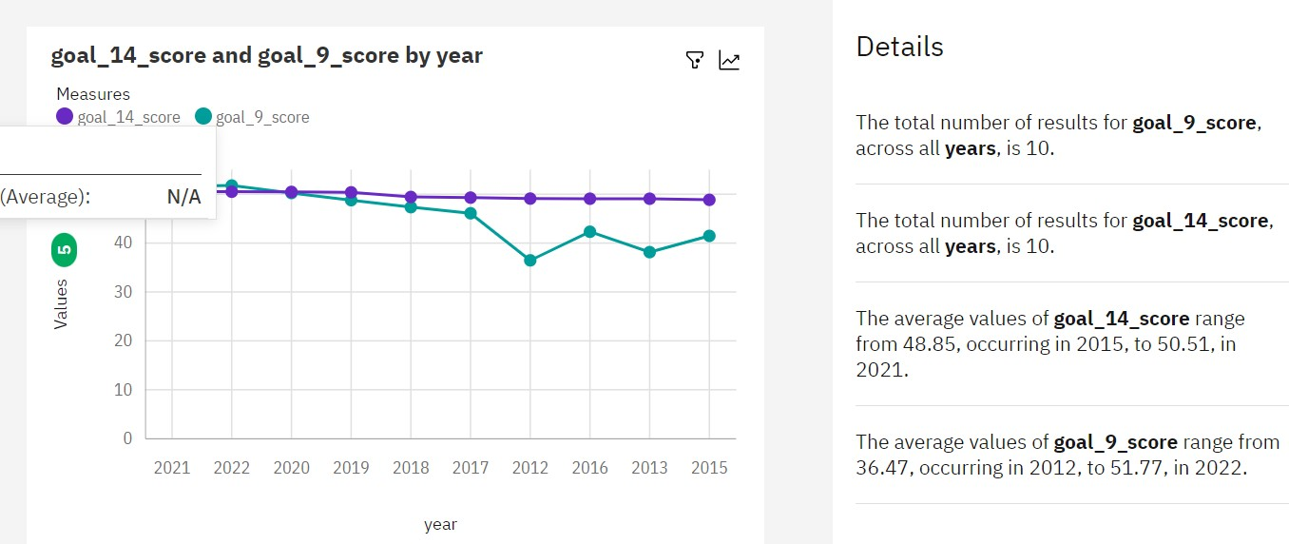
Analysis on Overall Sustainability Industry, Innovation and Infrastructure
https://us1.ca.analytics.ibm.com/bi/?perspective=explore&pathRef=.my_folders
%2FVisualization%2BSustainability%2Bscore%2B14%2Band%2Bscore%2B4%2Be xploration&subView=model0000018c669ae69a_00000004

Slide 11
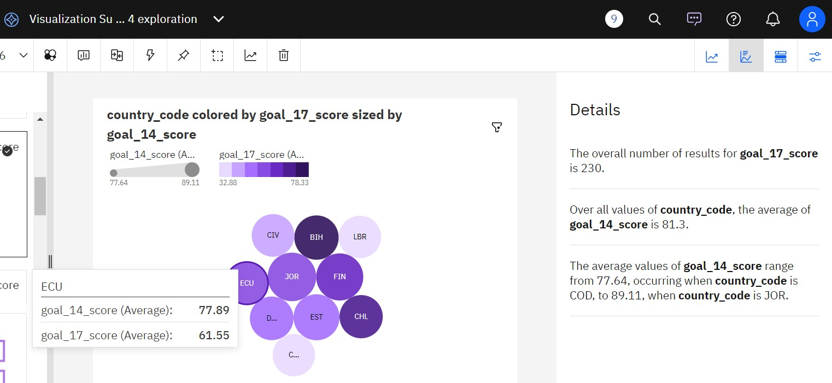
Analysis on Overall Sustainability Partnerships for the Goals
https://us1.ca.analytics.ibm.com/bi/?perspective=explore&pathRef=.my_folders%2FVisualization%2BSustainability%2Bscore%2B14%2Band%2Bscore%2B4%2Be xploration&subView=model0000018c669ae69a_00000004

Slide 12
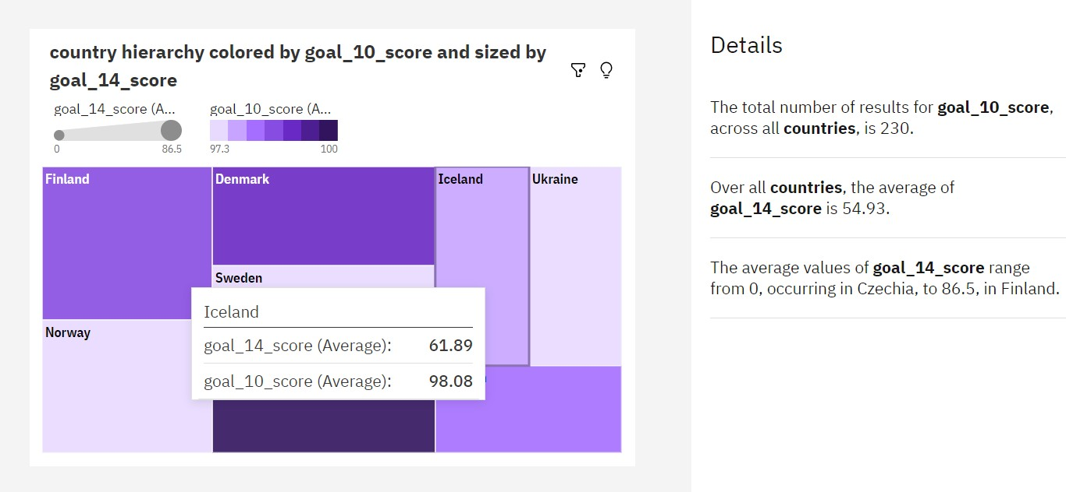
Analysis on Overall Sustainability Reduced Inequalities
https://us1.ca.analytics.ibm.com/bi/?perspective=explore&pathRef=.my_folders
%2FVisualization%2BSustainability%2Bscore%2B14%2Band%2Bscore%2B4%2Be xploration&subView=model0000018c669ae69a_00000004

Slide 13
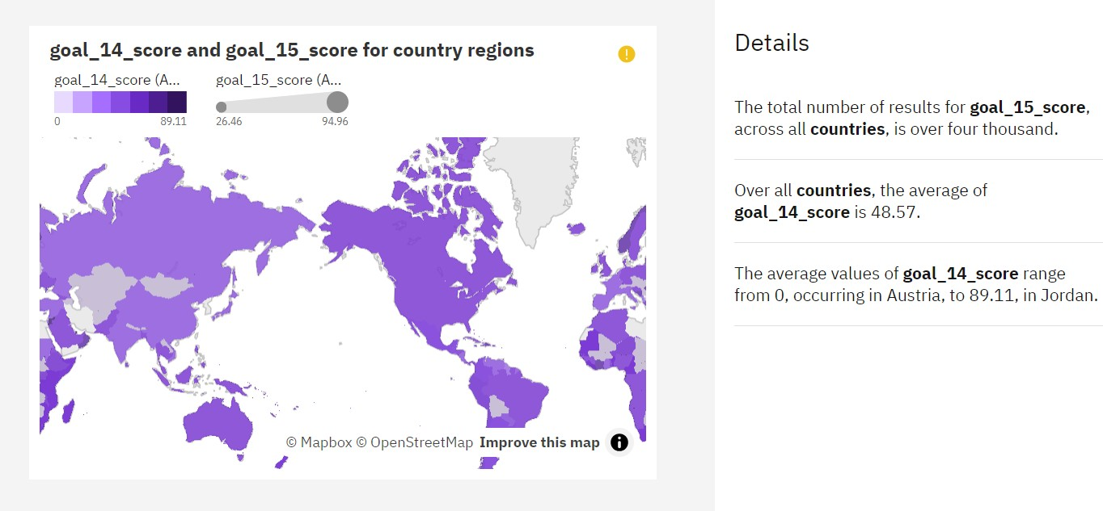
Analysis on Overall Sustainability Life On Land
https://us1.ca.analytics.ibm.com/bi/?perspective=explore&pathRef=.my_folders%2FVisualization%2BSustainability%2Bscore%2B14%2Band%2Bscore%2B4%2Be xploration&subView=model0000018c669ae69a_00000004

Slide 14
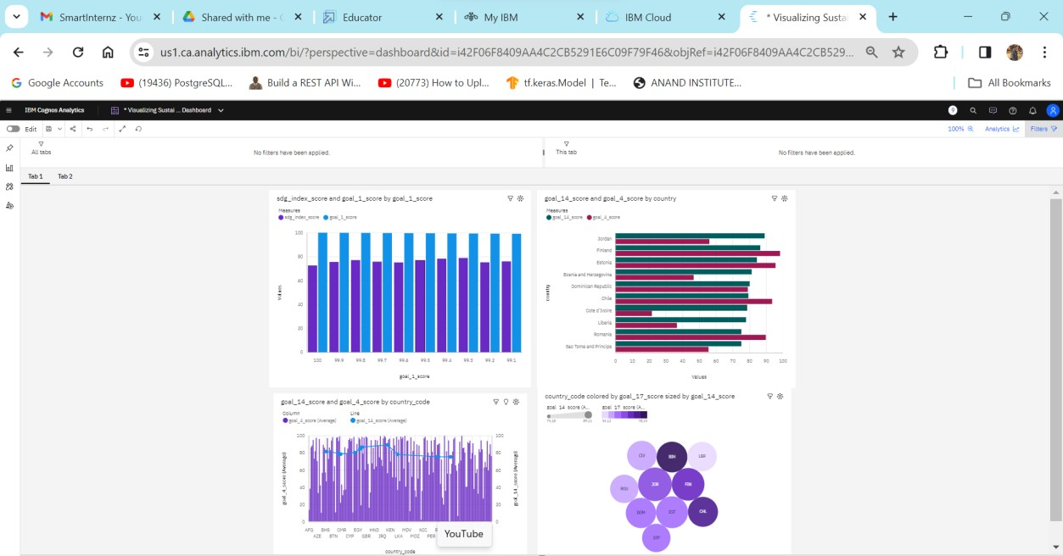
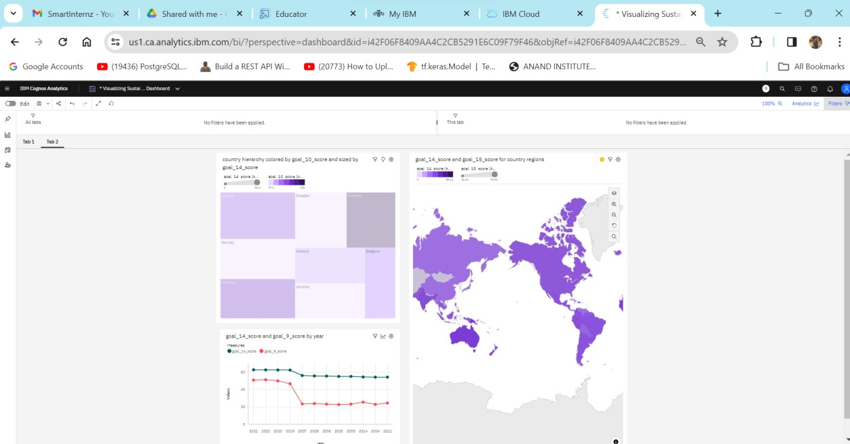
Responsive and Design of Dashboard
https://us1.ca.analytics.ibm.com/bi/?perspective=dashboard&pathRef=.my_folde rs%2FVisualizing%2BSustainability%2BDashboard&action=view&mode=dashboa rd&subView=model0000018c66ea0236_00000002
https://us1.ca.analytics.ibm.com/bi/?perspective=dashboard&pathRef=.my_folde rs%2FVisualizing%2BSustainability%2BDashboard&action=view&mode=dashboa rd&subView=model0000018c671337bd_00000000

Slide 15
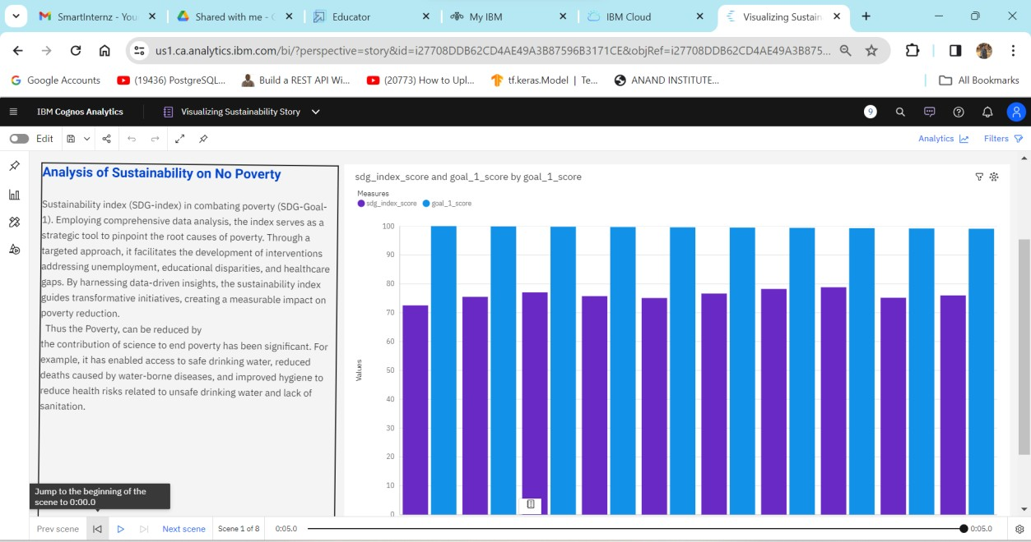
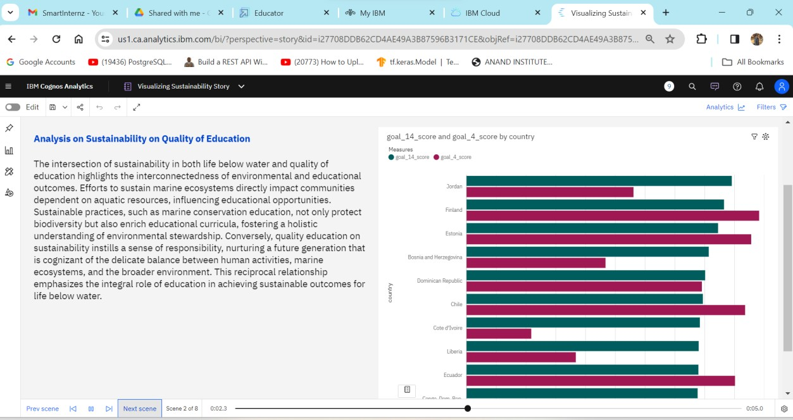
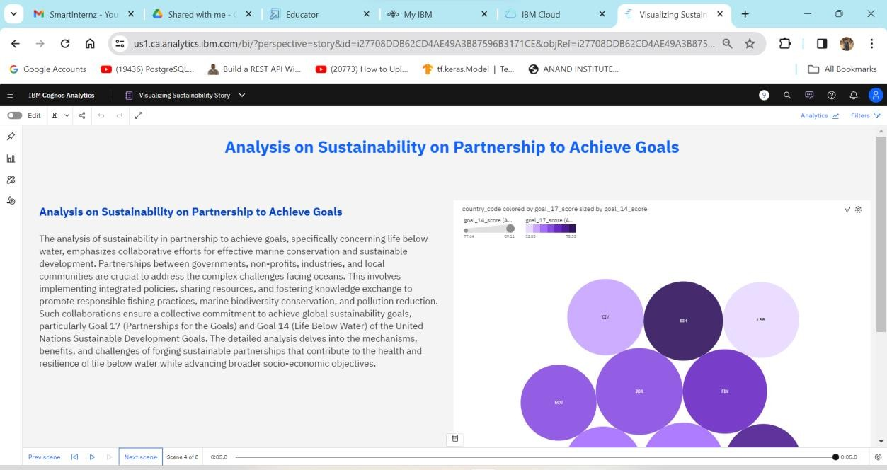
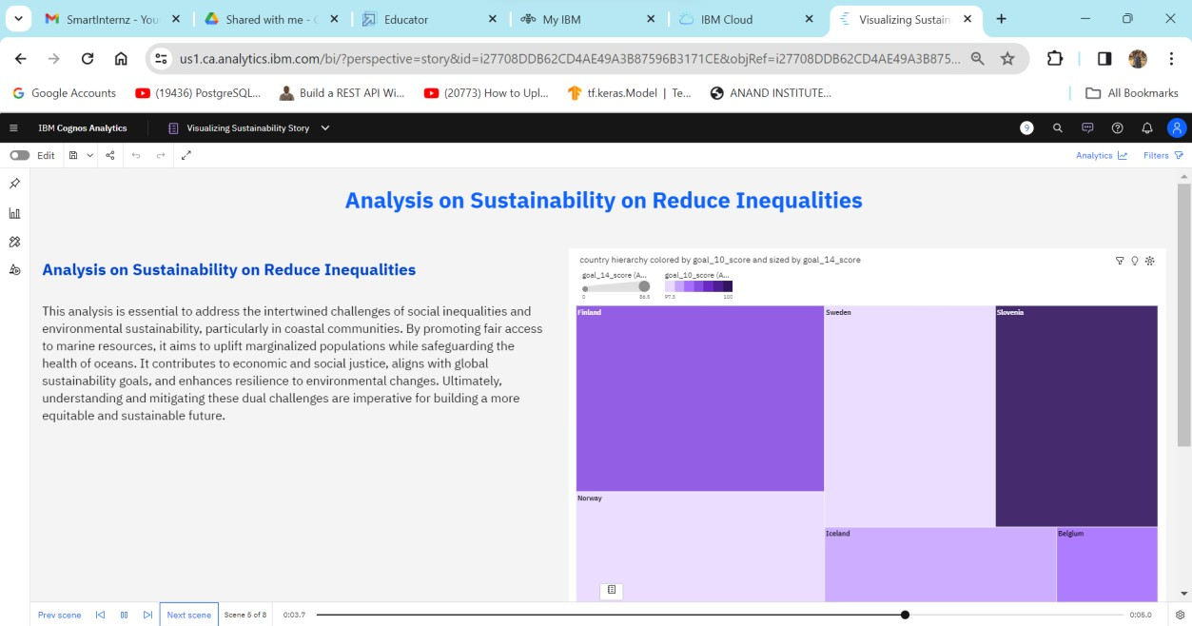
Story
No of Scenes of Story (7 scenes)

Slide 16
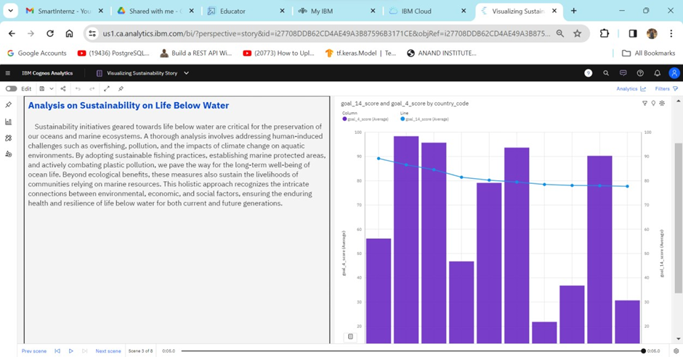
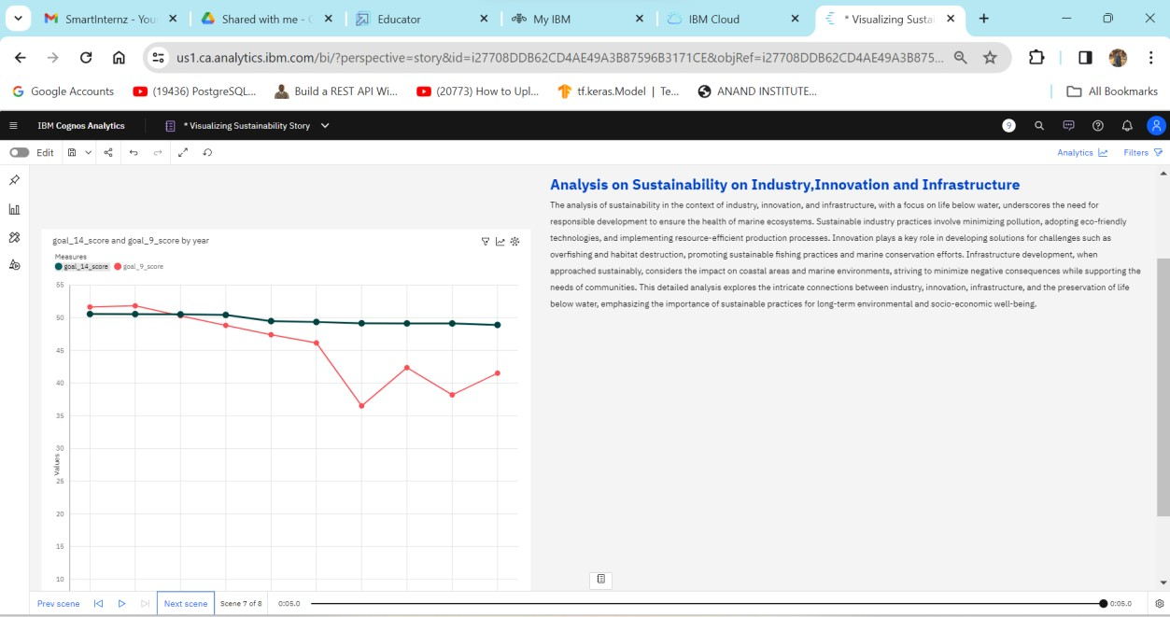
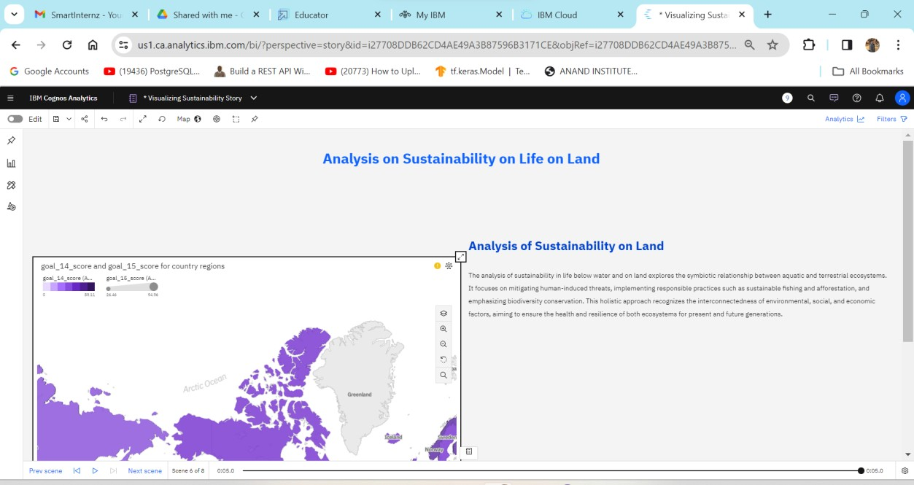
https://us1.ca.analytics.ibm.com/bi/?perspective=story&pathRef=.my_folders%2 FVisualizing%2BSustainability%2BStory&action=view&sceneId=model0000018cb 6ccc693_00000002&sceneTime=0

Slide 17
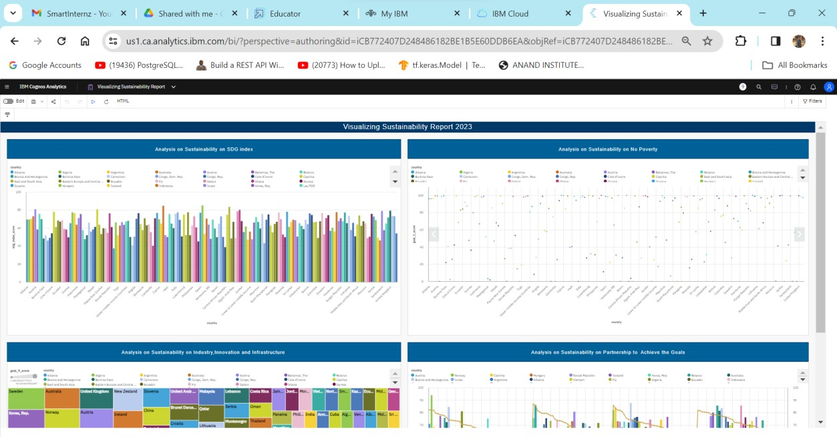
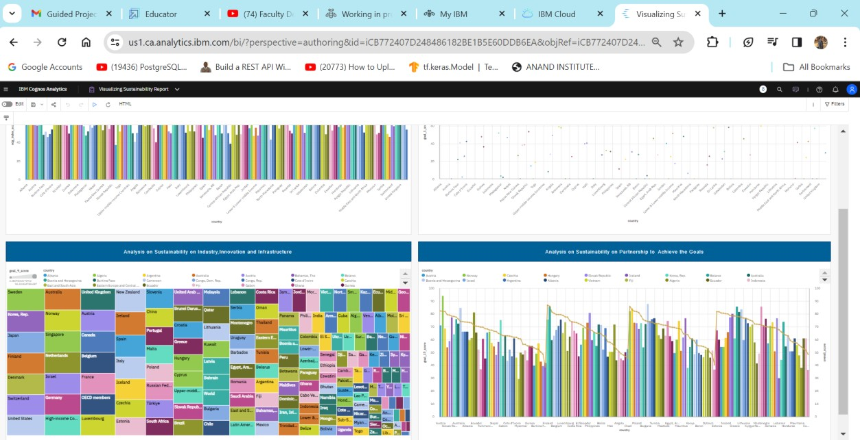
REPORT
https://us1.ca.analytics.ibm.com/bi/?pathRef=.my_folders%2FVisualizing%2BSust ainability%2BReport&action=run&format=HTML&prompt=false

Slide 18
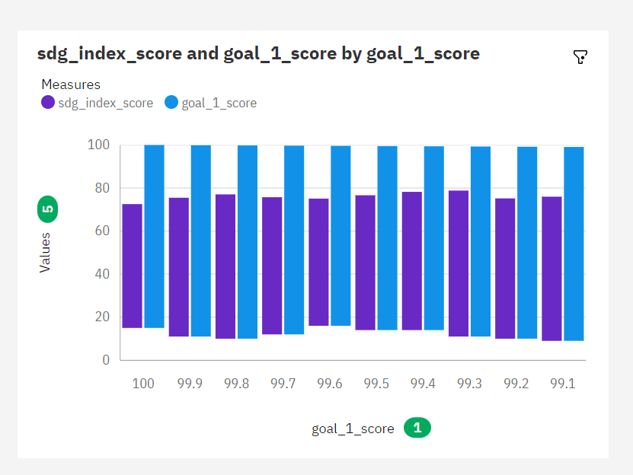
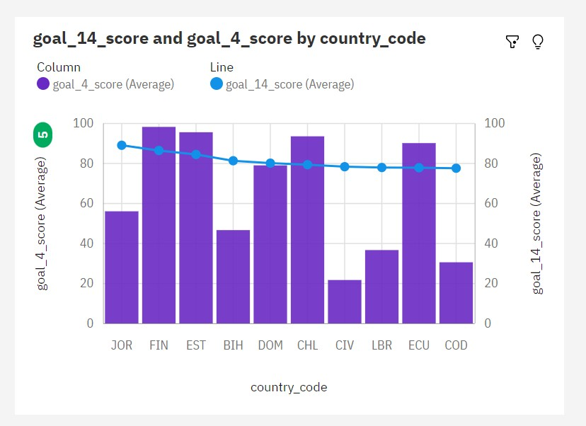
Performance Testing
Amount of Data Rendered to DB ‘
Utilization of Data Filters
No of Visualizations/ Graphs
Analysis on overall sustainability on No Poverty
Analysis overall sustainability on Quality Education
Analysis on overall sustainability Life Below Water
Analysis on over all sustainability Partnerships for the Goals
Analysis on overall sustainability Reduced Inequalities.
Analysis on overall sustainability Industry, Innovation and Infrastructure.
Analysis on overall sustainability Life on Land

Slide 19
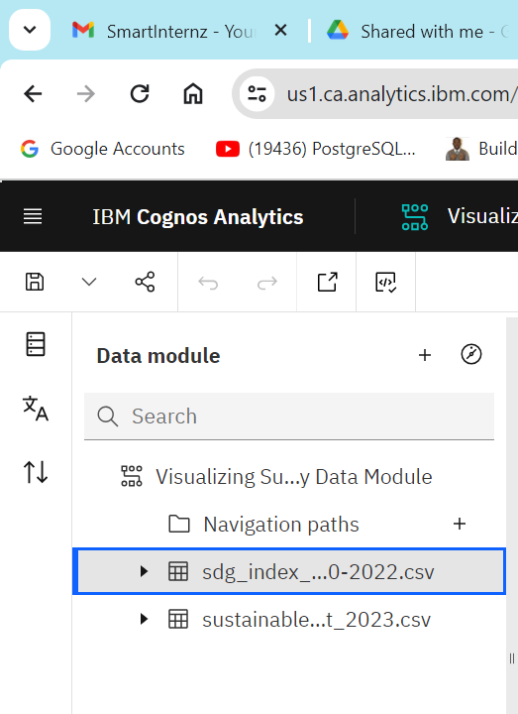
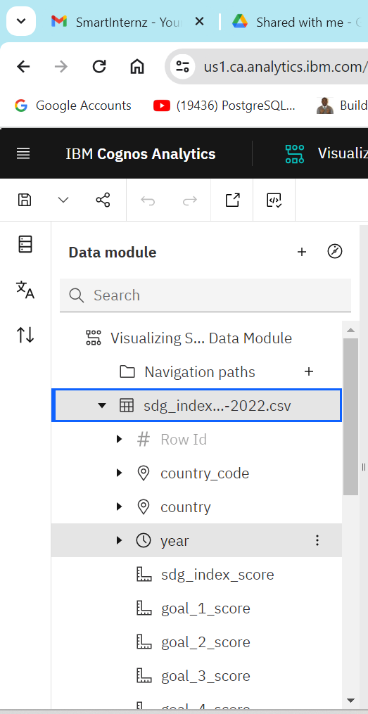
No of Calculation Fields

Slide 20
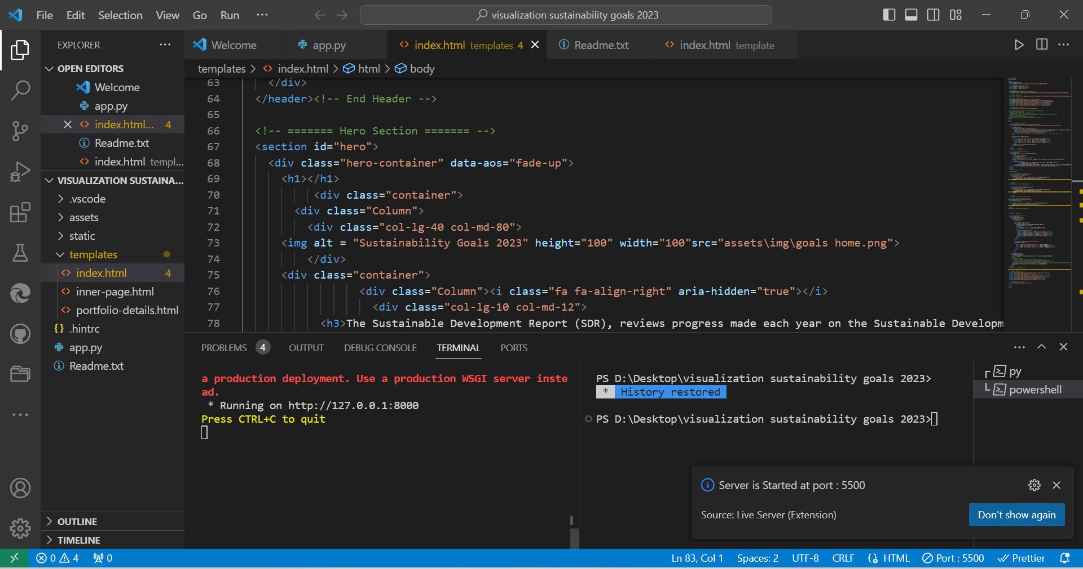
WEB INTEGRATION

Slide 21
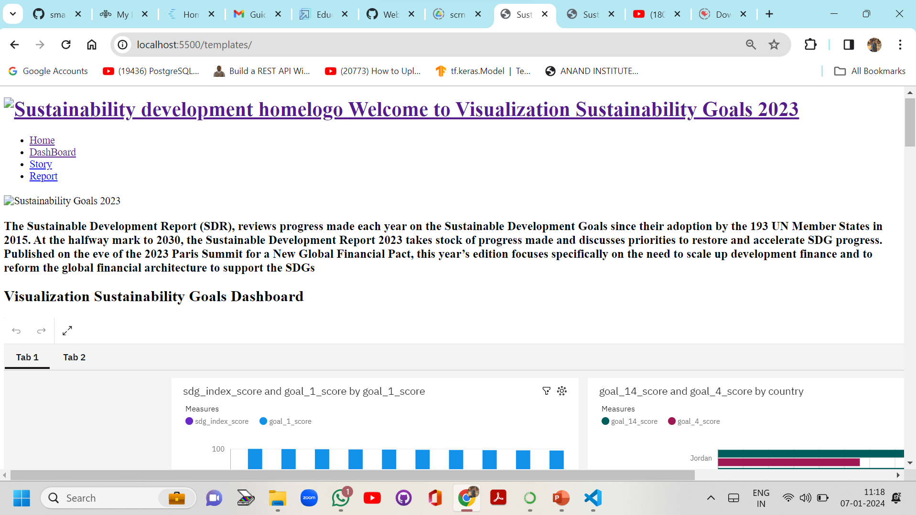
Server is Started at port : 5500

Slide 22
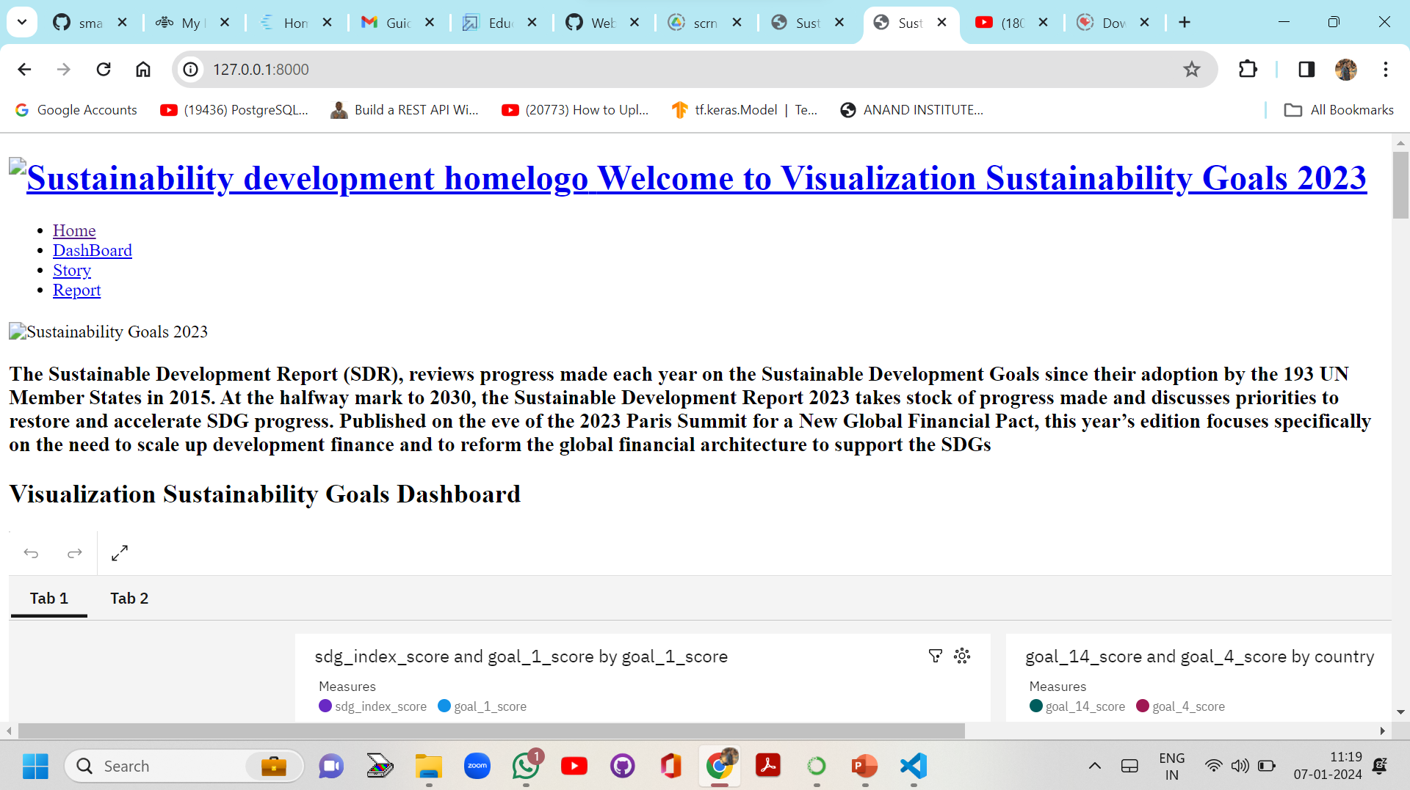
PS D:\Desktop\visualization sustainability goals 2023> py app.py runserver -d * Serving Flask app 'app' * Debug mode: off a production deployment. Use a production WSGI server instead. * Running on http://127.0.0.1:8000

Slide 23
Thank you

